Slide 1

AEC MID EVAL
Manikya Pant
Nitin Rama Sai

Slide 2
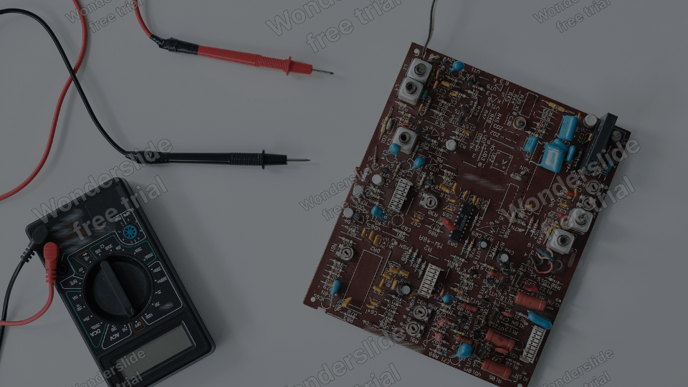
Design LT Simulations for: > LPF > Mixer > Oscillator
Project Workflow:
Resemble Simulations on Hardware and Verify
Prepare Project Report

Slide 3
Quadrature Down Converter Project
Making a quadrature down converter for modern wireless receivers
Implementing a switch (mixer), quadrature oscillator, and simple RC low pass filter
Assembling all components and implementing the Quadrature Down Converter

Slide 4
LT SPICE SIMULATION

Slide 5
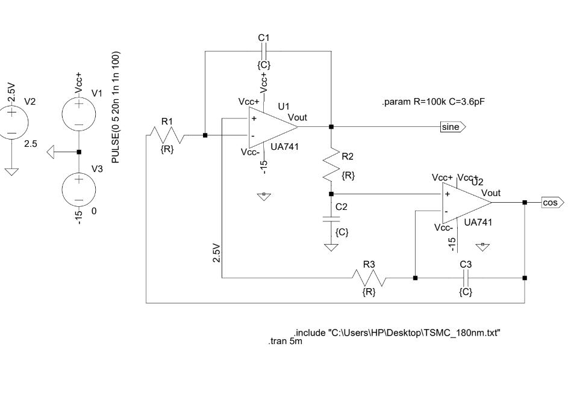

Slide 6
Mixer
Mixes two signals by switching action

Slide 7
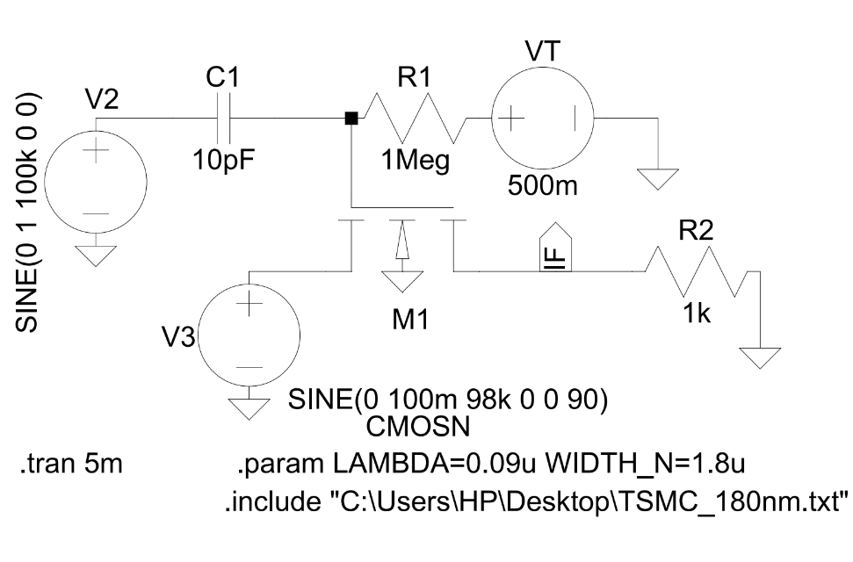
Mixer

Slide 8
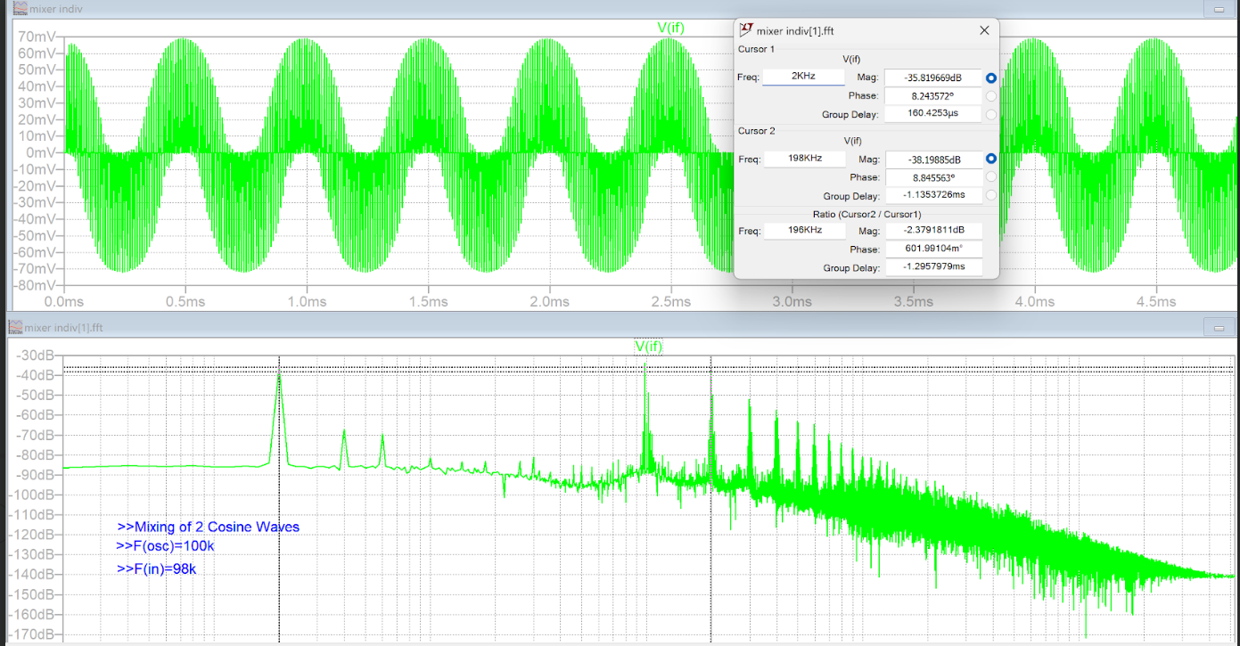
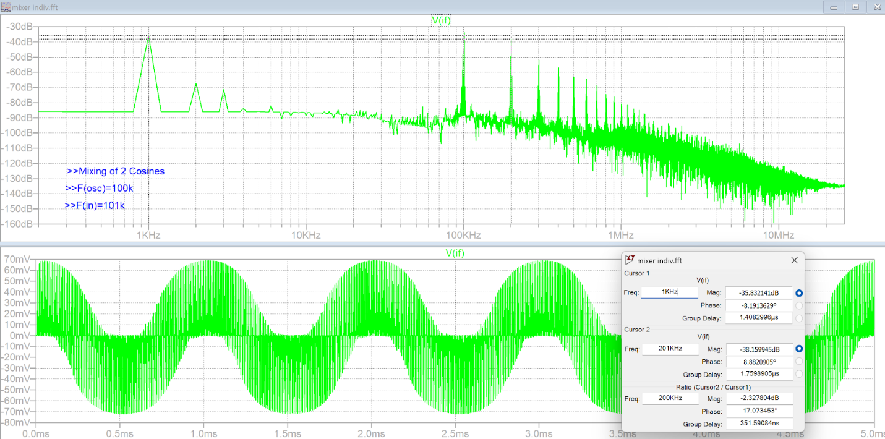
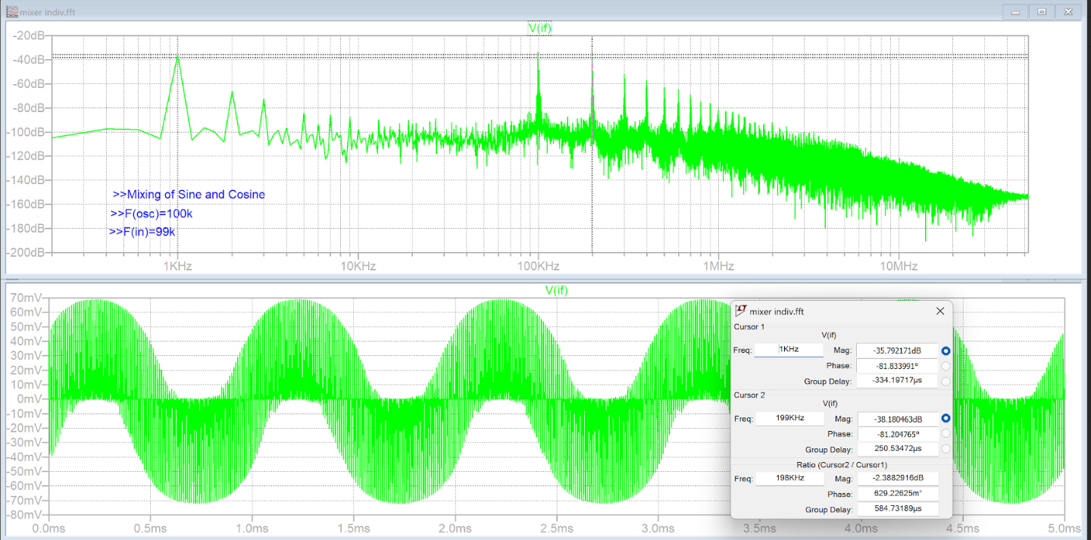
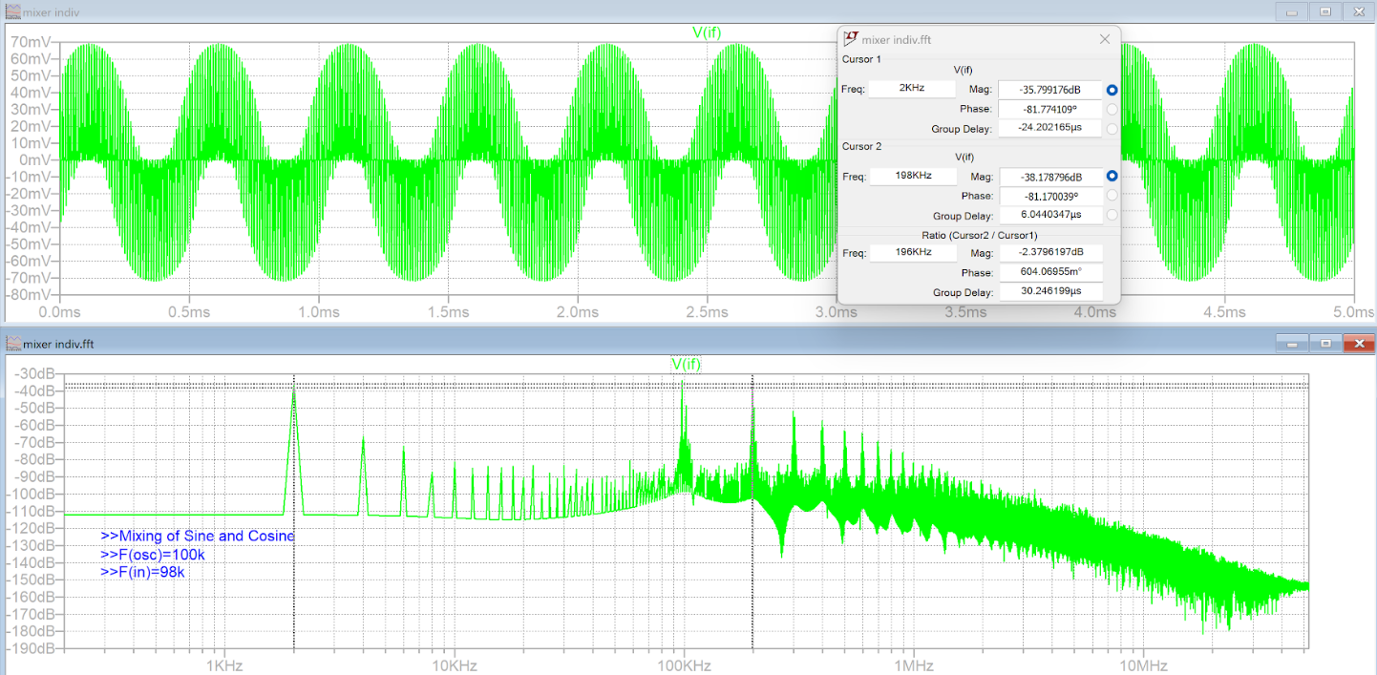

Slide 9
Low Pass
Filter

Slide 10
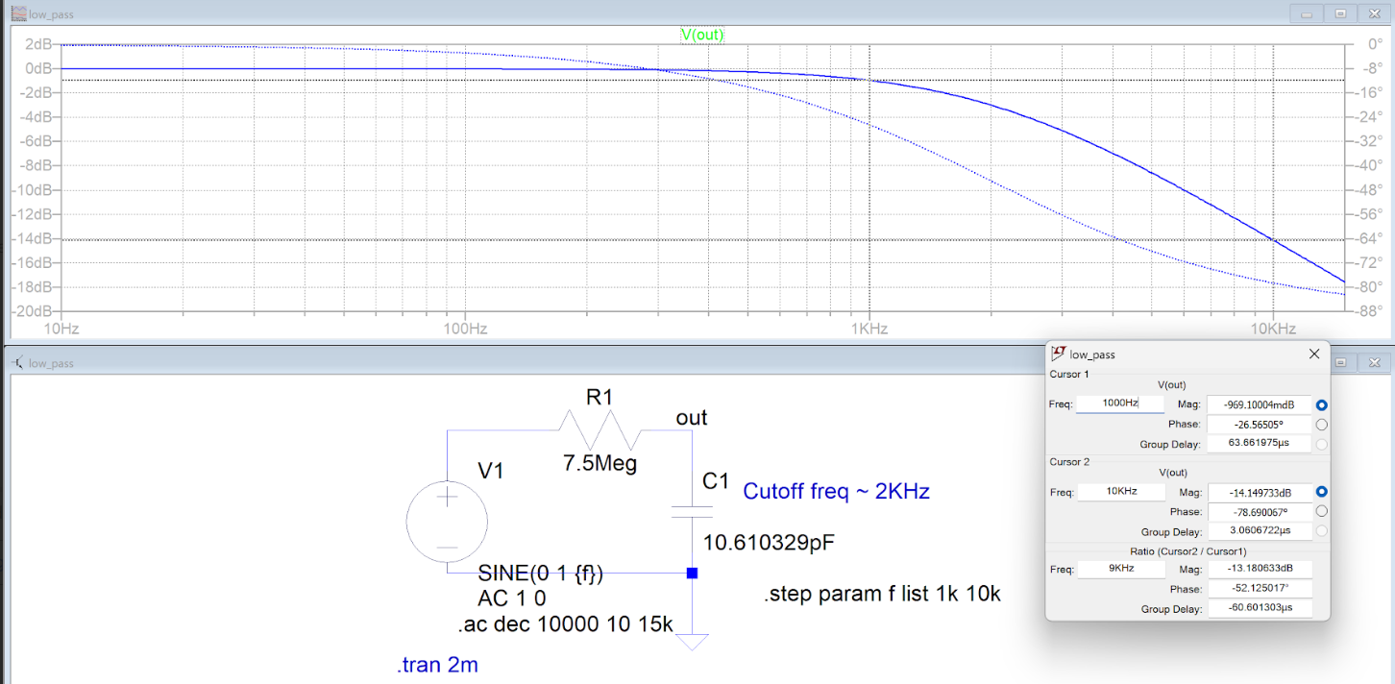

Slide 11
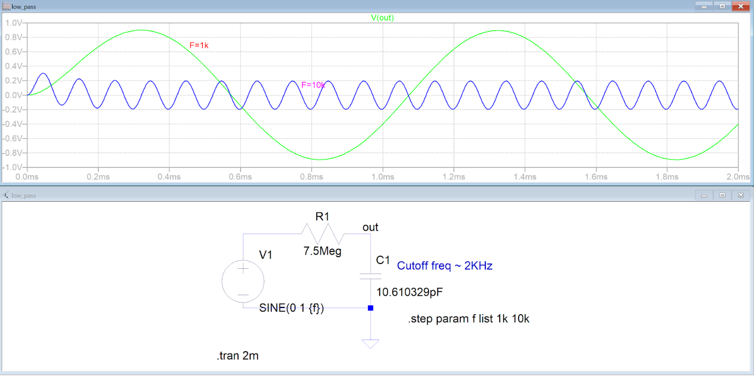

Slide 12
Low Pass
Filter + Mixer Combined

Slide 13
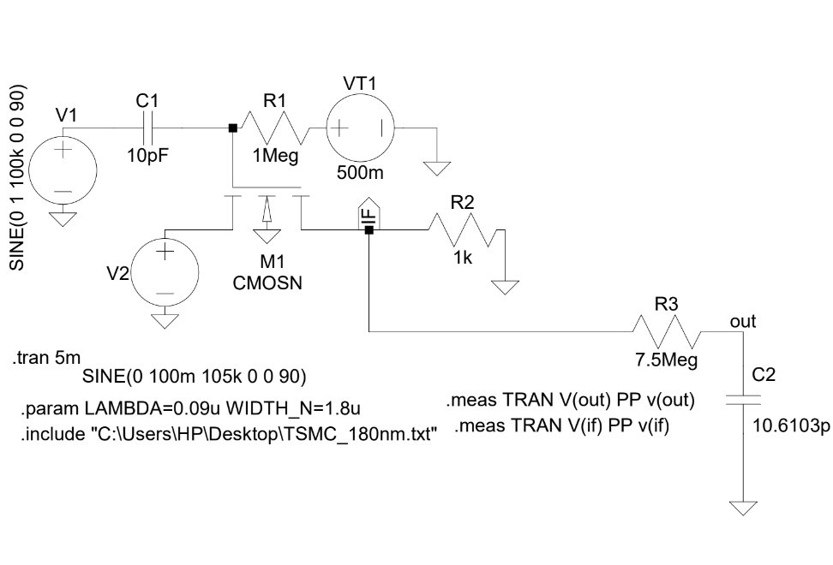

Slide 14
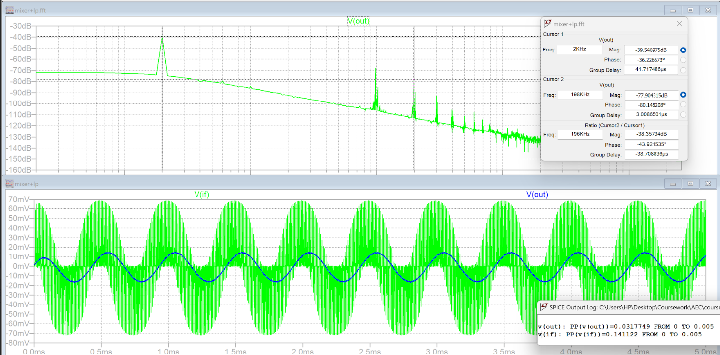

Slide 15
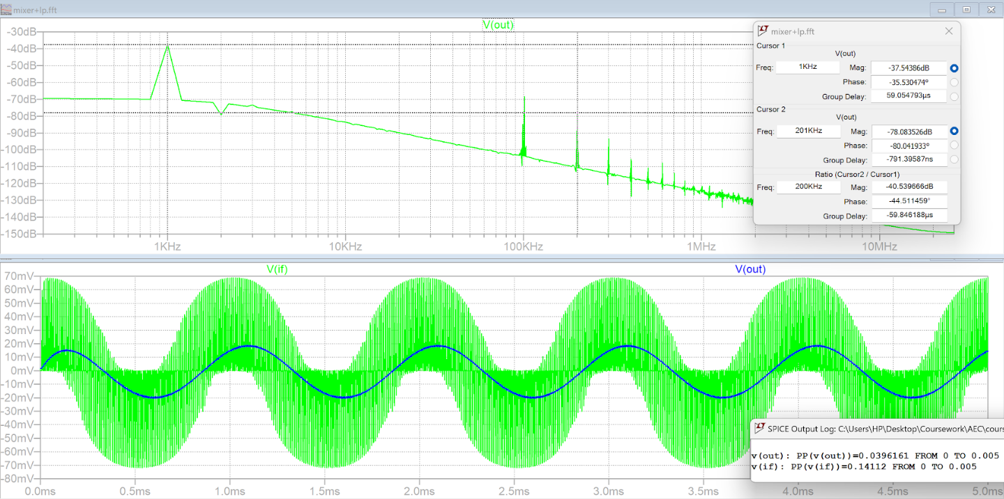

Slide 16
Quadrature Oscillator

Slide 17
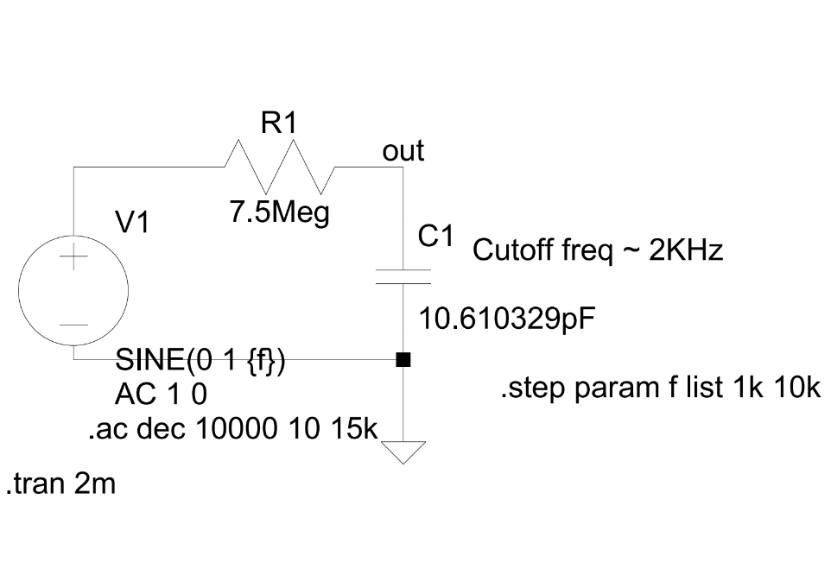

Slide 18
Full Circuit

Slide 19
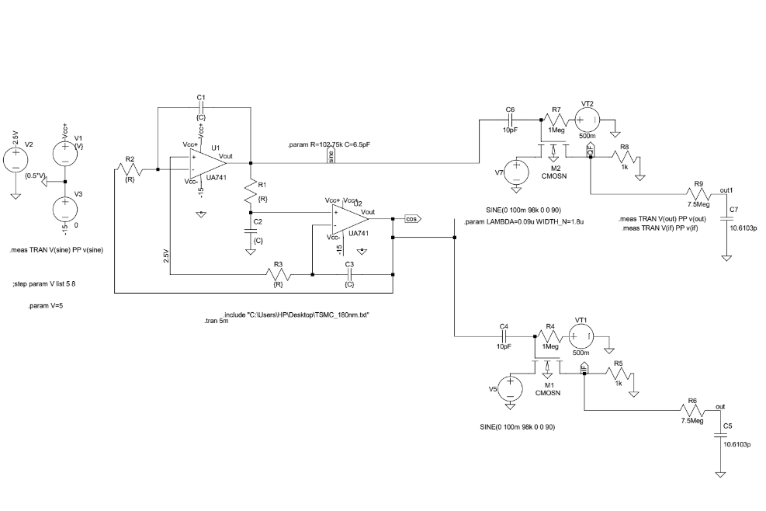

Slide 20
Thank You

